Slide 1
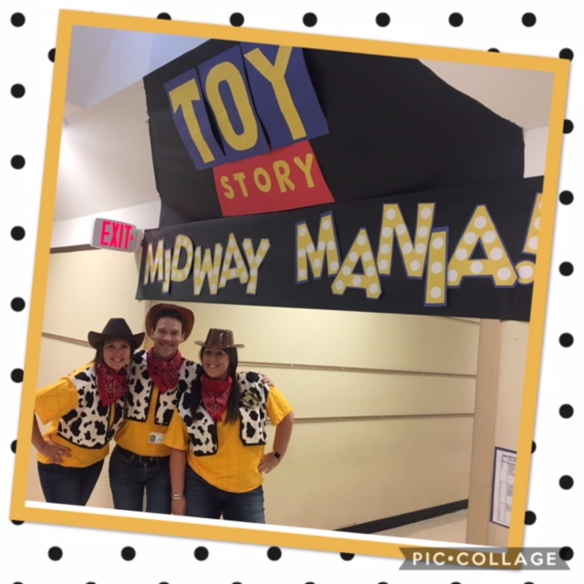
Wednesday August 29th 2018
Miss Linda Frey
freyl@billingsschools.org
(406)281-6226
There are lots of things to sign this time of year. The paperwork can be overwhelming. Just so Update form won’t be sent home anymore. You are going to need to fill out that white packet each year. Be sure to send in additional notes if you update any phone numbers, including emergency contacts for your child.
Since the packet includes a media permission slip, I am canceling the online form that I had pushed out (the one on the blue page of QR codes). Thanks for understanding.
Thank you to all families who signed up for Remind. I have 20 out of 25 already! Awesome!
Text:
3rdgrcharm
To: 81010
To sign up
Also, if you haven’t gotten into SeeSaw yet, download the Parent app and scan in with their QR code that came home last week. The kids are so excited to share what they’ve done in their ongoing digital portfolio. You can like and comment on their work too!
Toy Story: Midway Mania
Back to school in 3rd grade was a “Toy Story” transformation celebration! I have loved getting to know each of your children and can’t wait to learn more. We practiced lots of skills with Toy Story in mind. This included measurement, reading comprehension strategies and lots of routines and procedures. Their favorite was, “Andy’s coming!” and they all pretended to be immobile toys. They could move again when they heard, “Coast is clear!”
Caption describing photo above.
Photo: Mrs. Niemeyer, Mr. Corcoran and Miss Frey (the 3rd Grade teaching team)
Upcoming Events
TOPIC
TOPIC
TOPIC
Sept. 3rd – No School (Labor Day)
Sept. 5th – Riddle Homework Due
Sept. 6th – Open House/Kona Ice 5:30-7:00 pm
(Kona Ice will be selling shaved ice)
Sept.11th – Patriot Day (wear red, white and/or blue)
Sept. 14th – Picture Day
Sept. 22nd – Saturday Live @Pioneer Park 10:00 am
Text to introduce the list below:
Item one
Item two
Item three
Item four
Item five
Text to introduce the list below:
Item one
Item two
Item three
Item four
Item five
Text to introduce the list below:
Item one
Item two
Item three
Item four
Item five
Homework
Who am I? Write 4 clues in neat handwriting on flaps
This assignment is coming home today.
(Due Wednesday Sept. 5th)

